Slide 1
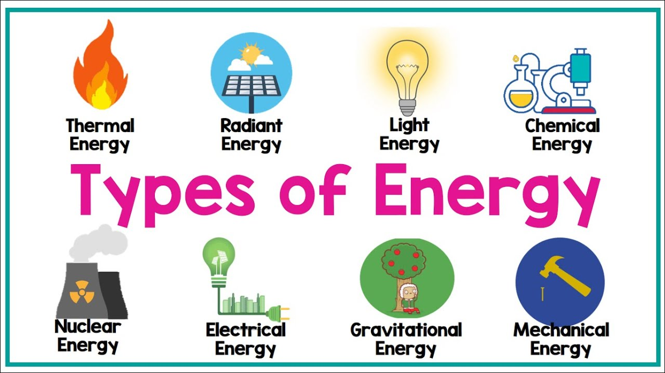
Energy

Slide 2
Sources of Energy

Slide 3
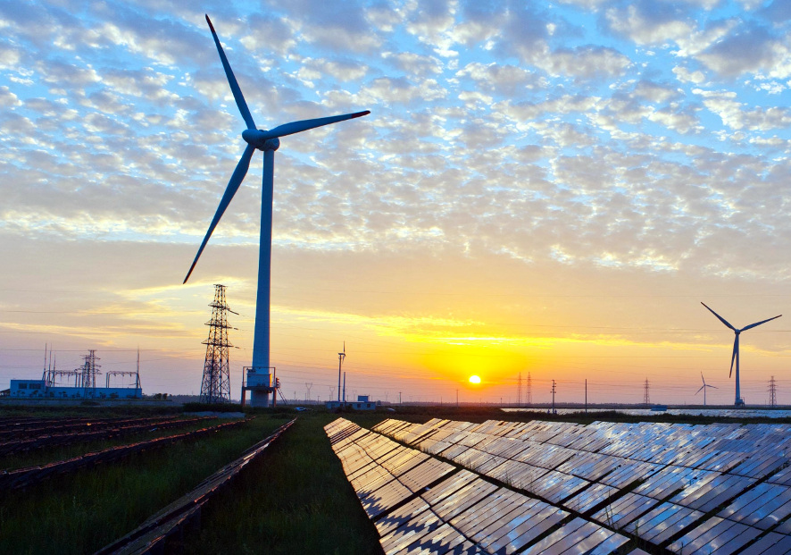
About Energy
Energy is the capacity of a physical system to perform work.
Energy exists in several forms such as;
Heat
Kinetic
Or mechanical energy;
Light
Potential energy
Electrical
Or other forms.

Slide 4
What are Energy Problems?
Pollution & Climate Change
Burning fossil fuels releases toxic gases into the atmosphere such as carbon dioxide, which cause climate change and other environmental problems.
1
2
3
Resource Depletion
Inequality of Access
The Earth's reserves of fossil fuels are running out, and this will have enormous impacts on our daily lives.
Access to energy is still a major issue in many parts of the world, and without equal access, it can be difficult to grow economically and improve public health systems.

Slide 5
Causes of Energy Problems
Population Growth Consumerism
As the world's population grows, more people need energy for their daily activities, which puts pressure on energy resources.
Our society places a lot of emphasis on material goods, which requires more energy to produce, transport, and dispose of.
Lack of Innovation
Lack of Political Will
The energy industry needs to innovate to keep up with ever-growing demand and scarce resources.
Leadership is critical in driving change and in creating and implementing policies that incentivize sustainable energy practices.

Slide 7
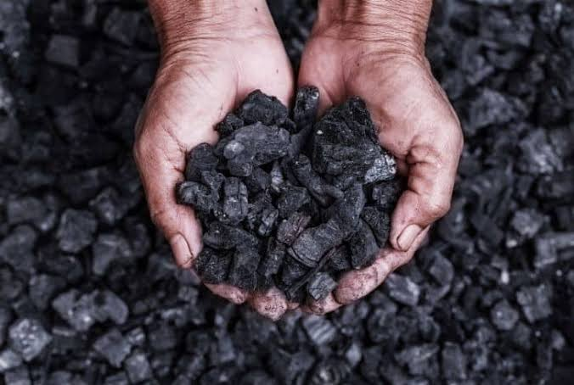
Conventional Energy Sources
The term “Conventional” means “not unusual or extreme or ordinary.” Conventional energy sources are the traditional sources of energy like coal and petroleum. Conventional energy sources are finite. They will not last forever.
Coal Coal releases large amounts of energy when it is burned because of the density of the hydrocarbons in the material. Coal is formed by dead plants being put under significant pressure and temperature for millions of years. There are four grades of coal: lignite, subbituminous, bituminous coal and anthracite. Bituminous coal is the best for releasing energy and is the most commonly mined type of coal.

Slide 8
Renewable Energy Sources
Renewable energy is natural energy which does not have a limited supply. Remewable energy can be used again and again, and will never run out.
Renewable energy is energy which comes from natural resources such as sunlight, wind, rain and tides and geothermal heat, which are renewable.
Renewable energy is an alternative to fossil fuels and nuclear power, and commonly called alternative energy.

Slide 9
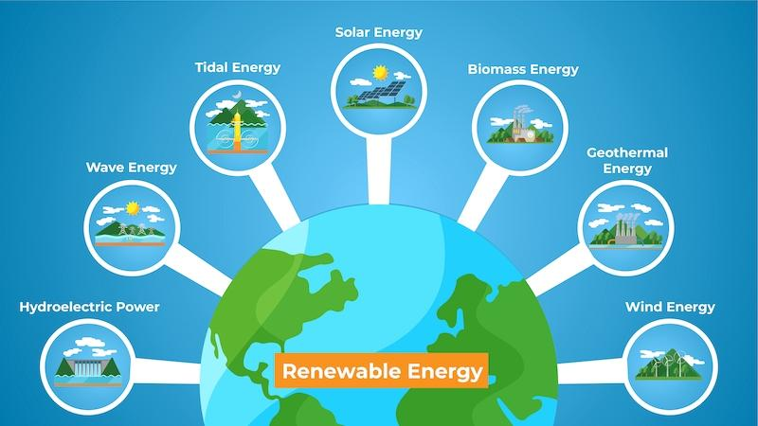
Renewable Energy Sources
A list of renewable energy sources: Biomass Geothermal Solar Tidal Wave Wind Wood Renewable energy replaces conventional fuels in four distinct areas: power generation hot water/ space heating transport fuels and rural (off-grid) energy services.

Slide 11
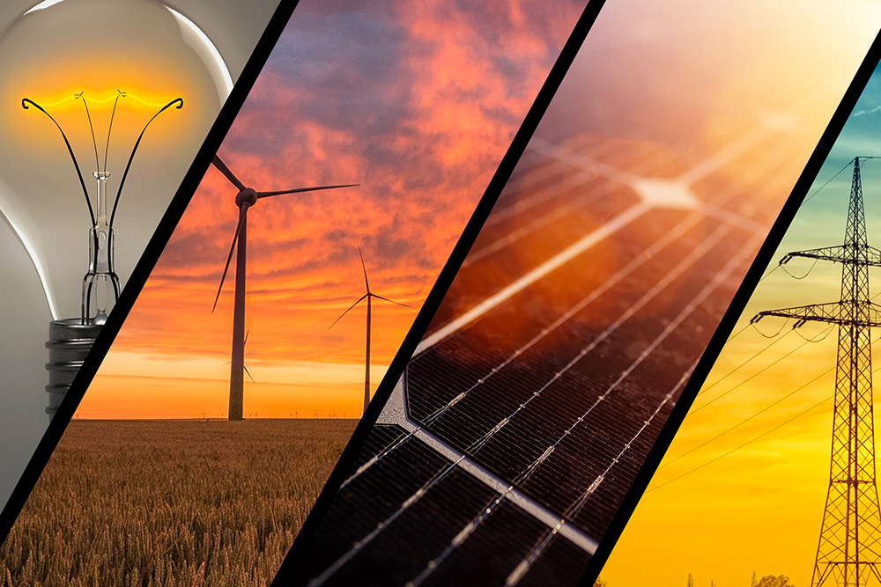
Why do we need energy?
Energy is the ability to do work. We must have energy in order to survive. This means that our society has to develop ways to produce the energy that we need. Energy is needed for:
Transportation Food Production Manufacturing Medicine/Healthcare Housing/Shelter
Basically, without the energy to satisfy our basic needs- we die!

Slide 12
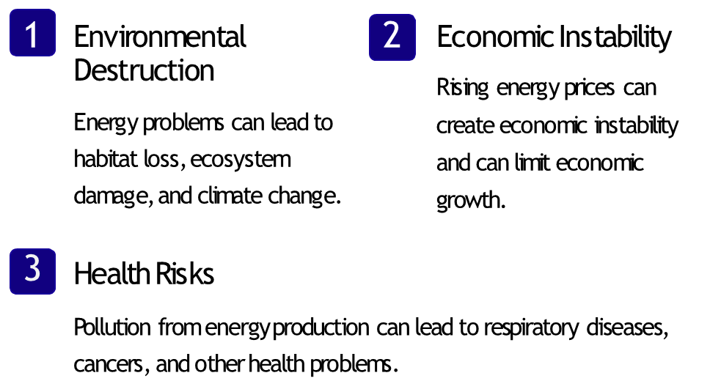
Consequences of Energy Problems

Slide 13
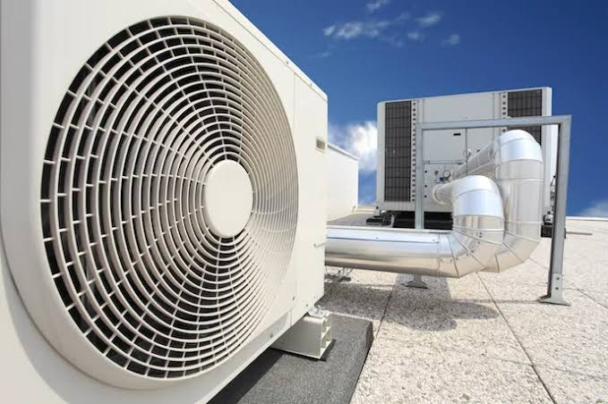
Areas that are in need of energy in Turkey
Heating and cooling
Transportation
Petrochemical industry
Industrial energy
Agriculture and irrigation

Slide 14
Turkey’s Renewable Energy Sources

Slide 15
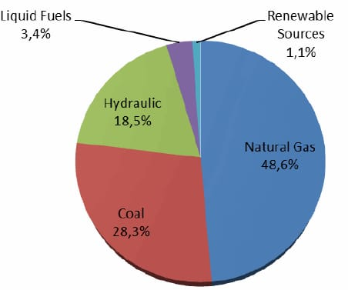
Energy Problems In Turkey
Turkey gets %80 of it’s energy from abroad. This is the root cause of the problems.
One of the reasons for the recent crisis in energy supply is the inadequacy of natural gas storage.

Slide 16
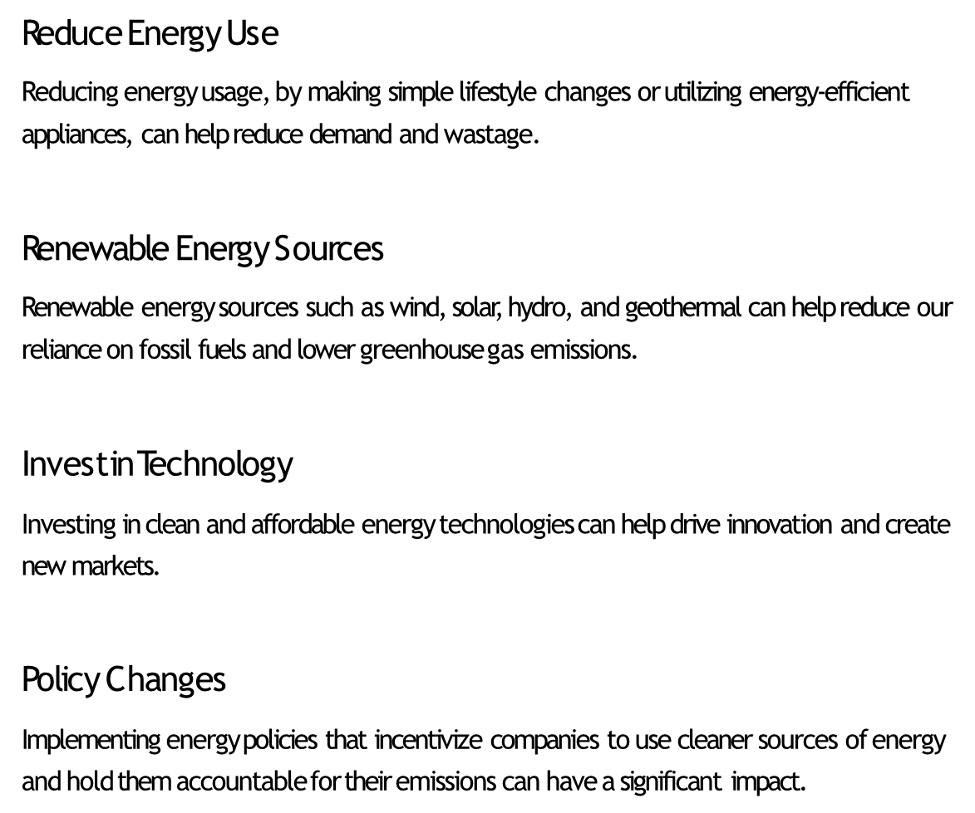
Solutions to Energy Problems

Slide 17
Now that we know about the problems, Let’s discuss how we can solve it!
The successful and effective supply of energy based on renewable resources to the greatest possible level is the radical solution to our nation’s energy issue.

Slide 18
Now let’s discuss more about the energy in the world!
-How much energy do you use every day? -Do you try to save energy? -What do you think of the world’s hugely increasing energy needs? -Do you think solar cells, wind farms, tidal power, hydropower and thermal energy will solve our future energy needs? -How would you solve an energy problem? -What do you think is the biggest problem in energy? -Why is energy important? -How does energy affect the climate change?

Slide 19
